Slide 1

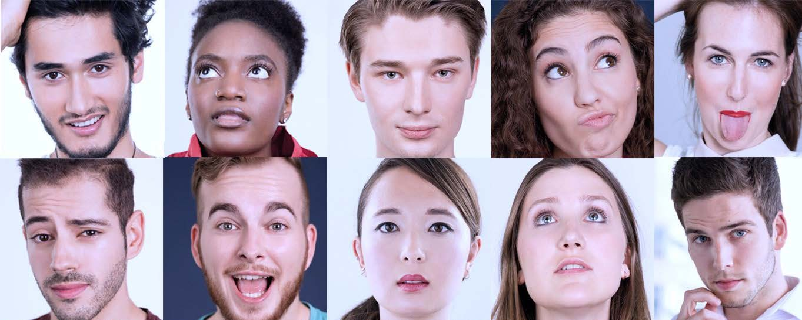

Vegetable/Fruit Gripper Sorter
Mechatronics 1 & Design Methodology
Team:
Ankit Pandey
Tigran Pletser
Julien Van Delft

Slide 2
Vegetable/fruit gripper sorter
Problem
Small food companies want to speed up their production process but have a low budget and produce different types of fruits and vegetables along the year
Solution
Speed up the chain by making an automated sorting process flexible enough to work with lots of different fruits and vegetables
Advantages
Autonomous allows the company to work 24/7
Cheap solution allows to support small companies

Slide 3

User Needs
User Needs
Speed up the production chain
Be human safe
Not damage the fruit/vegetable when moving it
Flexibility to handle different fruits/vegetables
Low cost
Able to sort the fruits/vegetables by matureness
Work in cold environment
Autonomous process
Adapted to a conveyor belt speed
Reliability
Plugged in a commercial plug
Who will use it?
The product designed for the food industry and more specifically for small companies making different fruits and vegetables with restricted budget, needing an automatised production chain

Slide 4
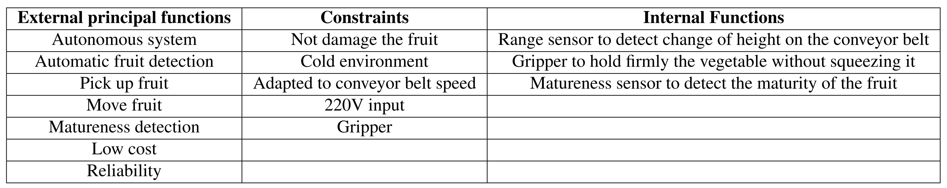
Functions

Slide 5
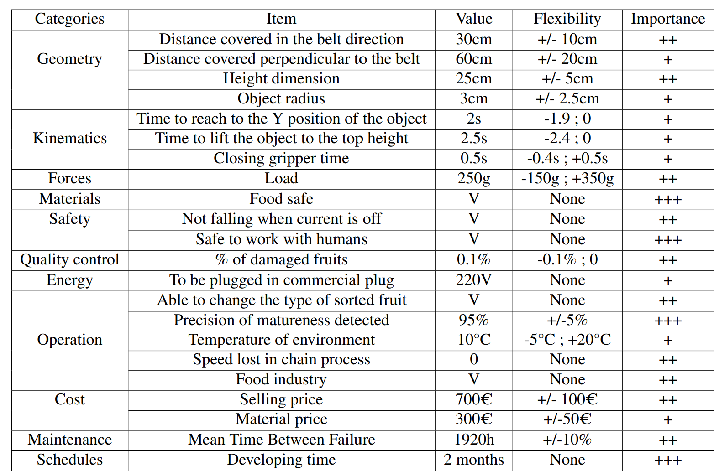
Requirement List

Slide 6
Essential problems
Essential problems | Means
Finding the fruits on the conveyor belt | Means of object detection
Getting to the fruits on the conveyor belt | Means of displacement
Grabbing the fruits on the conveyor belt | Means of grabbing the object
Identifying the matureness of the fruits based on their colour | Means of colour identification
Transferring the fruits to the sorting area | Means of position control
Doing the sorting autonomously | Means of autonomous system

Slide 7
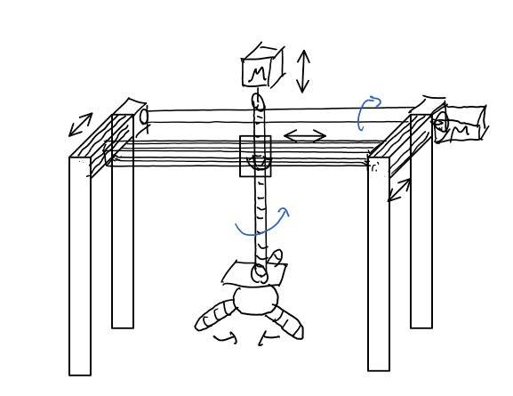
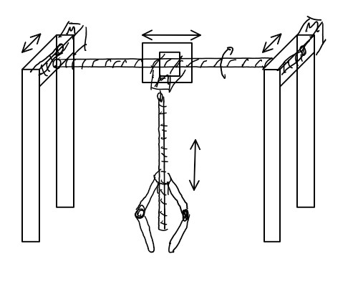
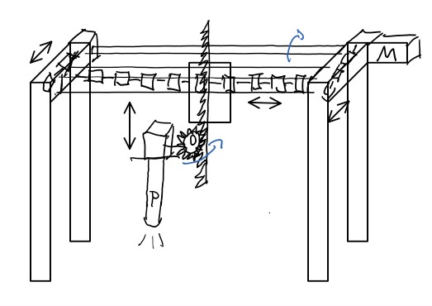
Conceptual Drawings
Lead screws with mechanical gripper
Chains and rack & pinion with vacuum gripper
Belts and lead screw with soft gripper

Slide 8
Conceptual Design – Selection Criteria
Features | Means | Easily Compatible with the overall task | Fulfils demands of requirements list | Realisable in principle | Within permission costs | Incorporate direct safety measures | Remarks | Decision
Power | Electric | + | + | + | + | + |  | +
 | Steam | - | - | + | - | + | Difficult to implement | -
 | Petrol | - | - | + | - | + | Too much power for what is needed | -
 | Diesel | - | - | + | - | + | Too much power for what is needed | -
Displacement | Cartesian | + | + | + | + | ? | Rigid | +
 | Cylindric | + | + | ? | ? | - | Need more space around | ?
 | Spherical | ! | + | ? | - | - | Hit the fruits on the front | -
 | Articulated | + | + | + | - | - | Hard to implement | -
 | Parallel | + | + | ? | - | - | Need special upper fixation | -
XY axis | Belts | + | + | + | + | ? | Fast and cheap | +
 | Screw | + | - | + | + | ? | Slow | -
 | Gears | ? | - | - | + | ? | Difficult to implement | -
 | Chains | ? | ? | + | - | ? | Heavy | -
Z axis | Belts | + | + | - | + | - | Dangerous | -
 | Gears | + | ? | - | + | ? | Difficult to implement | -
 | Screw | + | + | + | + | + | Slow but precise and safe | +
 | Rack and pinion | + | + | + | - | + | Less precise and less safe | ?
Motors | Stepper | + | + | + | + | + | Fast and reliable | +
 | DC | + | + | + | + | - | No position control | -
 | Servo | + | - | + | + | + | Limited angle, not suitable | -
Object detection | Camera | - | - | + | - | + | Too much information to process | -
 | Ultrasonic distance sensor | + | - | + | + | + | Range not suitable | -
 | IR distance sensor | + | - | + | + | + | Environment not suitable | -
 | Sharp IR distance sensor | + | + | + | + | + |  | +
Grabbing | Soft Gripper | + | + | + | + | + |  | +
 | Mechanical Gripper | - | - | + | + | - | Not compatible with fragile object | -
 | Vaccuum Gripper | + | - | + | + | + | Suction might squeeze the current object | -
 | Magnetic Gripper | - | - | + | ? | + | Used for magnetic objects | -
Grabbing actuation | Pneumatic | + | + | + | + | + |  | +
 | Electric | - | - | - | + | + |  | -
Matureness identification | Camera | - | - | + | - | + | Too much information to process | -
 | Colour sensor | + | + | + | + | + | Precise enough for fruits and vegetables | +
 | Pheromon sensor | - | - | ? | ? | ? |  | -
Operation | Manual | + | - | + | + | - | Need human input | -
 | Automatic | + | + | + | + | + |  | +
Control | Arduino | + | + | + | + | + |  | +
 | Raspberry Pi | + | - | + | - | + |  | -
 | Computer | + | - | + | - | + |  | -

Slide 9
Justification for "Fulfill demands of requirement list"
XY axis
 | Speed | Load | Lifetime | Price | Precision | Lubrification
Requirements | Medium | Light | / | Low | Medium | /
Belts | Medium to High | Light | Small lifetime | Low | Medium | No need
Screw | Low | Medium | Medium | Low | High | Needed
Gears | High | High | High | High | High | Needed
Chains | Low | Medium | Medium | Medium | Low | Recommended
Actuated Gripper
 | Human-Robot Interaction | Actuation Speed | Cost | Handle delicate object
Requirements | High | High | Low | High
Soft Gripper | High | High | Low | High
Mechanical Gripper | Medium | Medium | Medium | Low
Vaccuum Gripper | High | Medium | Medium | Medium
Magnetic Gripper | Medium | High | High | Low
Z axis
 | Speed | Load | Lifetime | Price | Precision | Lubrification | Safety
Requirements | Low | Light | / | Low | High | / | High
Belts | Medium to High | Light | Small lifetime | Low | Low | No need | Low
Screw | Low | Medium | Medium | Low | High | Needed | High
Rack and Pinion | High | High | High | High | High | Needed | Medium
Motors
 | Speed | Working temperature
Requirements | 30 cm/s | 8-30°C
Stepper | V | V
DC | V | V
Servo | X | V

Slide 10
Morphological Chart
Features | Means
Power | Electric | Petrol | Steam | Diesel
Displacement | Cartesian | Arm | Parallel arms
XY axis Transmission | Belts | Chains | Gears | Screw
Motors | Stepper motor | DC motor | Servo
Z axis transmission | Screw | Belt | Gears | Chains
Object detection | Camera | Laser distance sensor | Ultrasonic distance sensor
Grabbing | Soft gripper | Mechanical gripper | Vacuum gripper | Magnetic gripper
Grabbing actuation | Pneumatic | Electric
Position control | End course switch | Rotary encoder
Matureness identification | Camera | Colour sensor | Pheromone sensor
Operation | Manually | Autonomous
Control | Arduino | Raspberry Pi | Computer

Slide 11
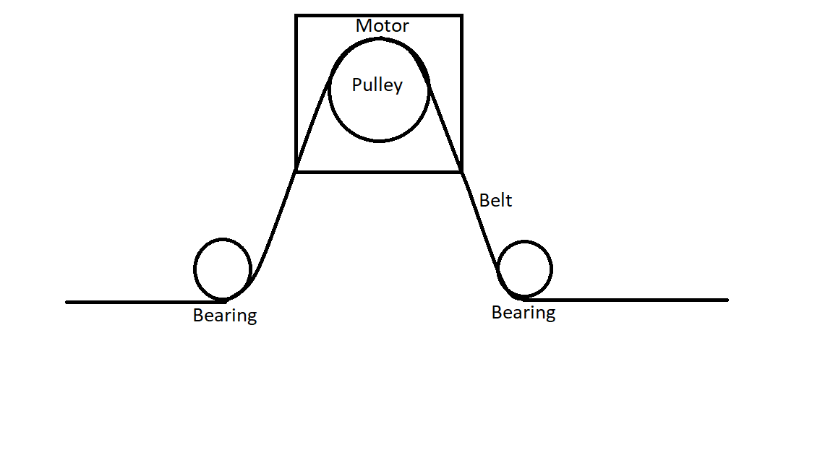
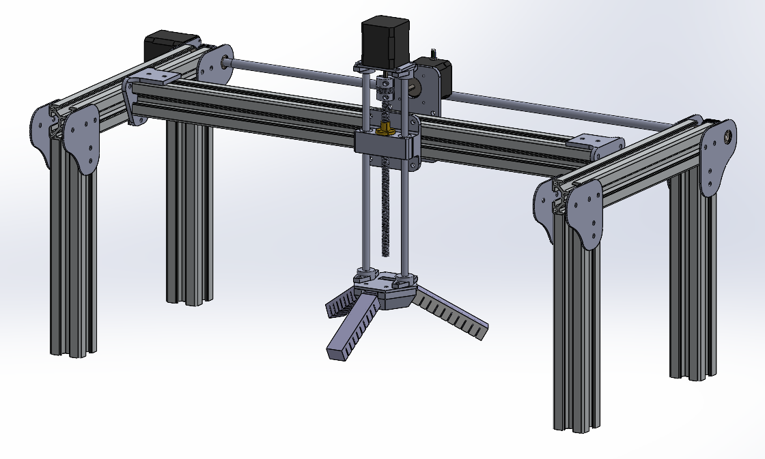
Final Design
X axis belt driven by a pulley
X axis belt driven by a pulley
Bearings rolling on the belt in the strut profile
Bearing
Leadscrew driven Z motion
Bearing

Slide 12
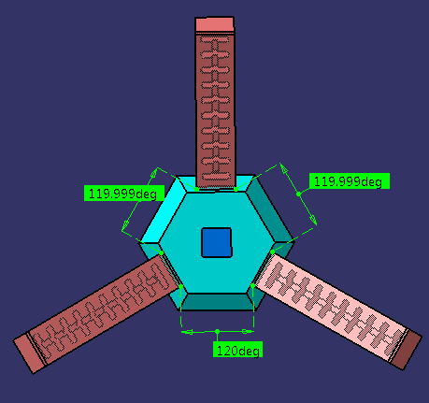
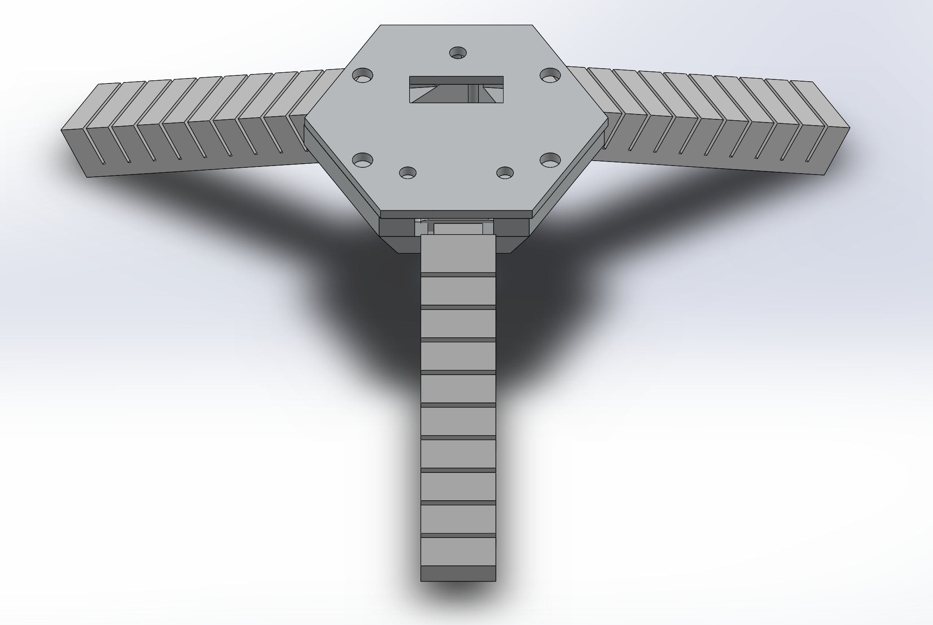
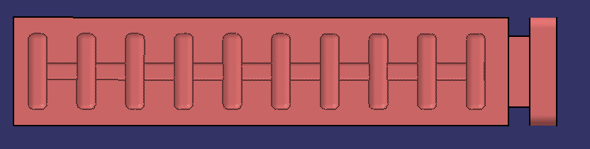
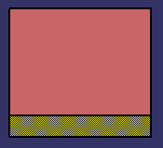
Soft Gripper Design
Advantages of Soft Gripper :
Picking and placing of object into packages while lowering the chance of damaging or bruising the product
Additional Level of flexibility from rigid grippers
Capable of working side-by-side with humans
Lower price point in comparison to current rigid robots
Design :
We considered a soft gripper, comprised of three soft fingers. The three soft fingers were arranged as the thumb, index, and middle fingers, since these are the most essential fingers for in-hand manipulation.
Color Sensor Position
120deg
120deg
Slots for Air flow
2- Layer Design
120deg
Layer 1 : Inflates with air pressure
Layer 2 : Solid body of gripper to hold object

Slide 13
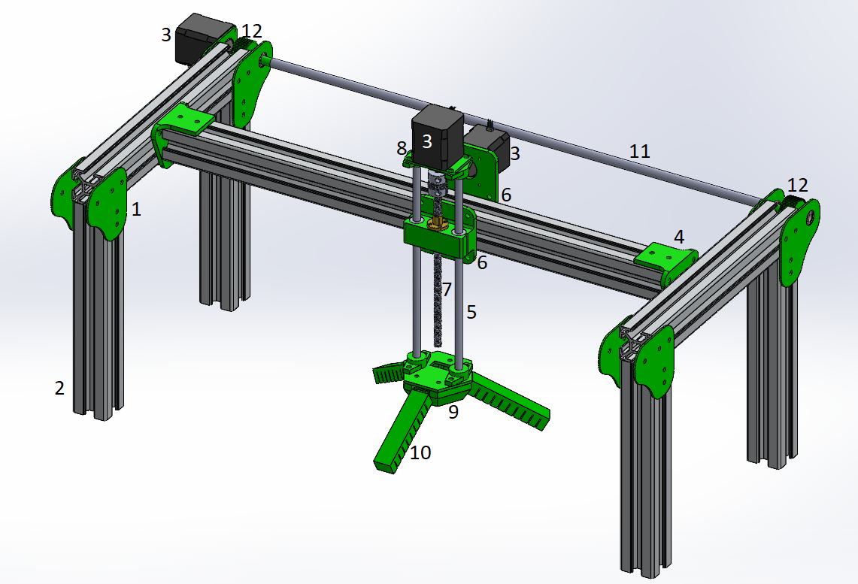
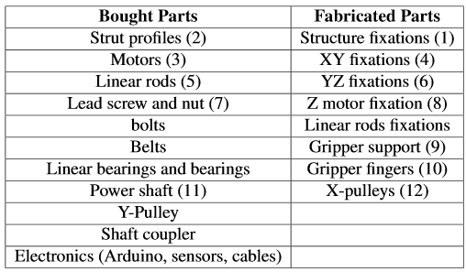
Parts
Fabricated parts are in green

Slide 14
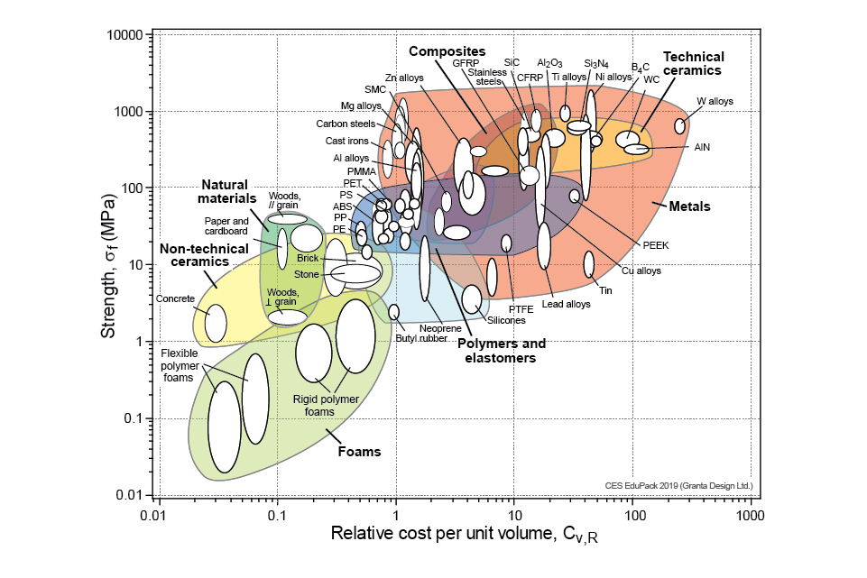
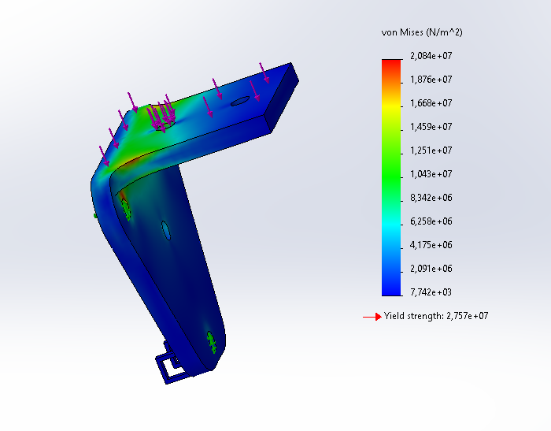
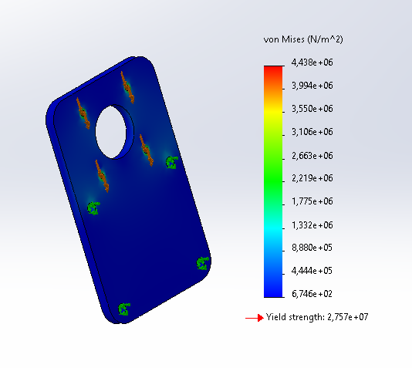
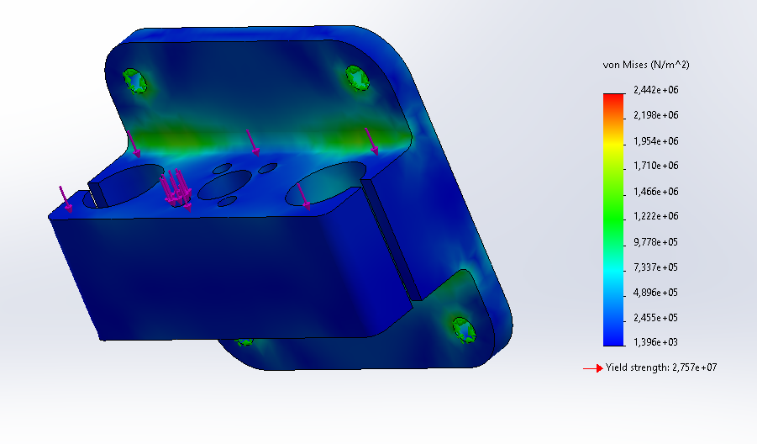
Material Choices
Most of the fabricated parts will be made in aluminium as it is cheaper than stainless steel
Even for the most loaded parts, aluminium can support it

Slide 15
Material Choices
The gripper itself is made of silicon:
Food safe
Hold a high pressure
Ease of fabrication

Slide 16
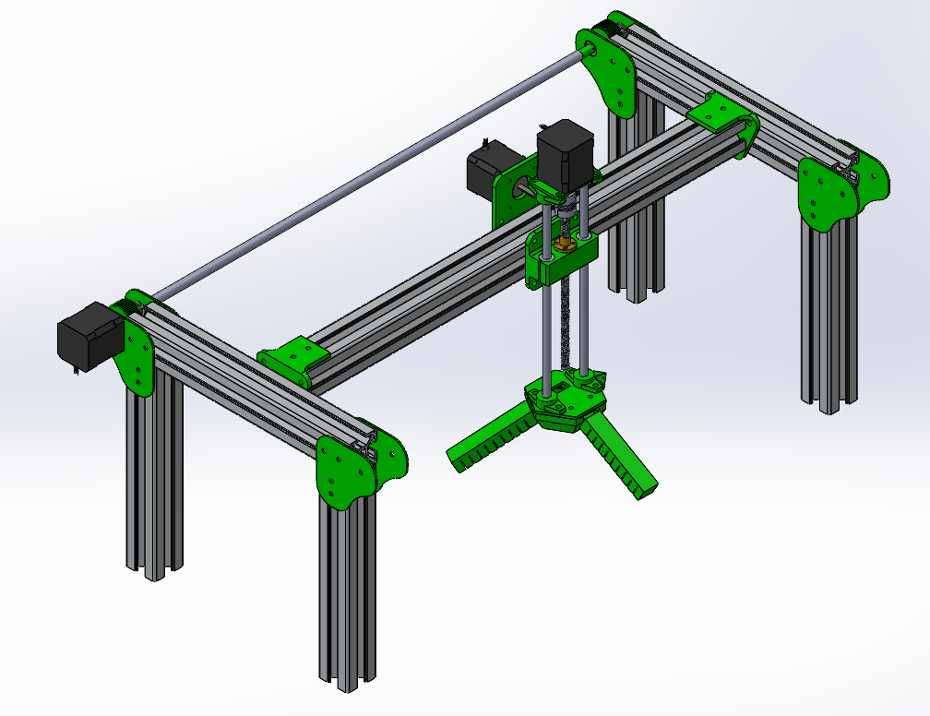
Manufacturing
Pieces | Small scale Manufacturing process | Large scale Manufacturing process
Flat fixations | Conventional machining (milling) | Sheet forming
XY fixations | Conventional machining | Sheet forming
YZ fixation / Gripper support / Pulleys | Sand casting | Low-pressure casting
Gripper fingers | Polymer casting | Injection moulded

Slide 17
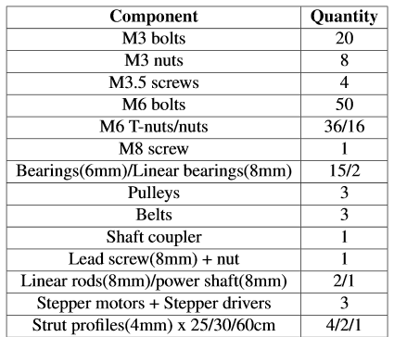
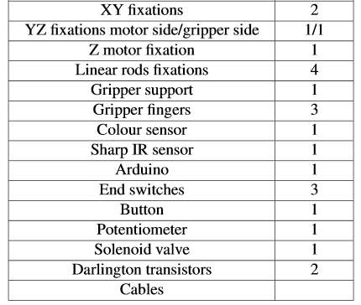
List of components

Slide 18
Assembly
Assembly Process Flow:
Motors fixed in the supports
Aluminium strut profiles fixed together
Bearings and power shaft fixed in the fixations
Gripper assembly with the motor and the leadscrew
XY fixations attached to the Y strut profile with the gripper and the belt
Y axis mounted on the structure with the X-axis belts
Cabling

Slide 19
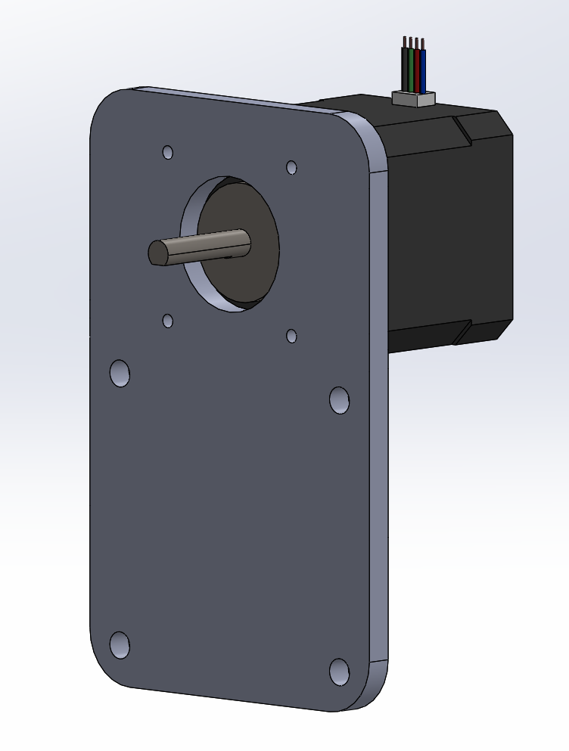
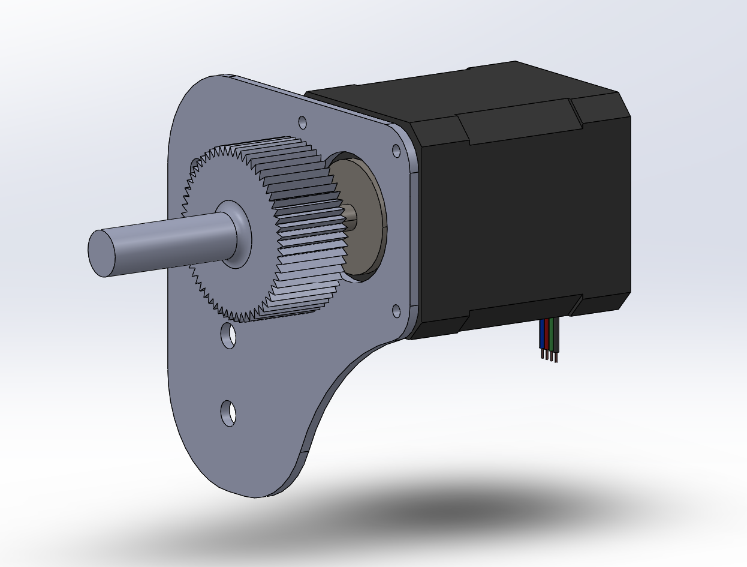
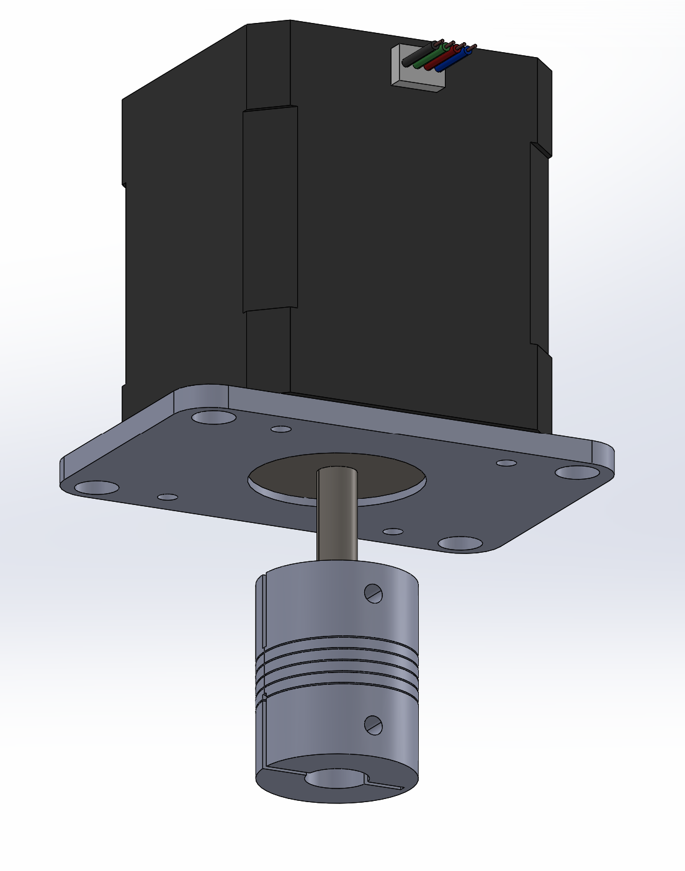
Step 1 – Motor fixed

Slide 20
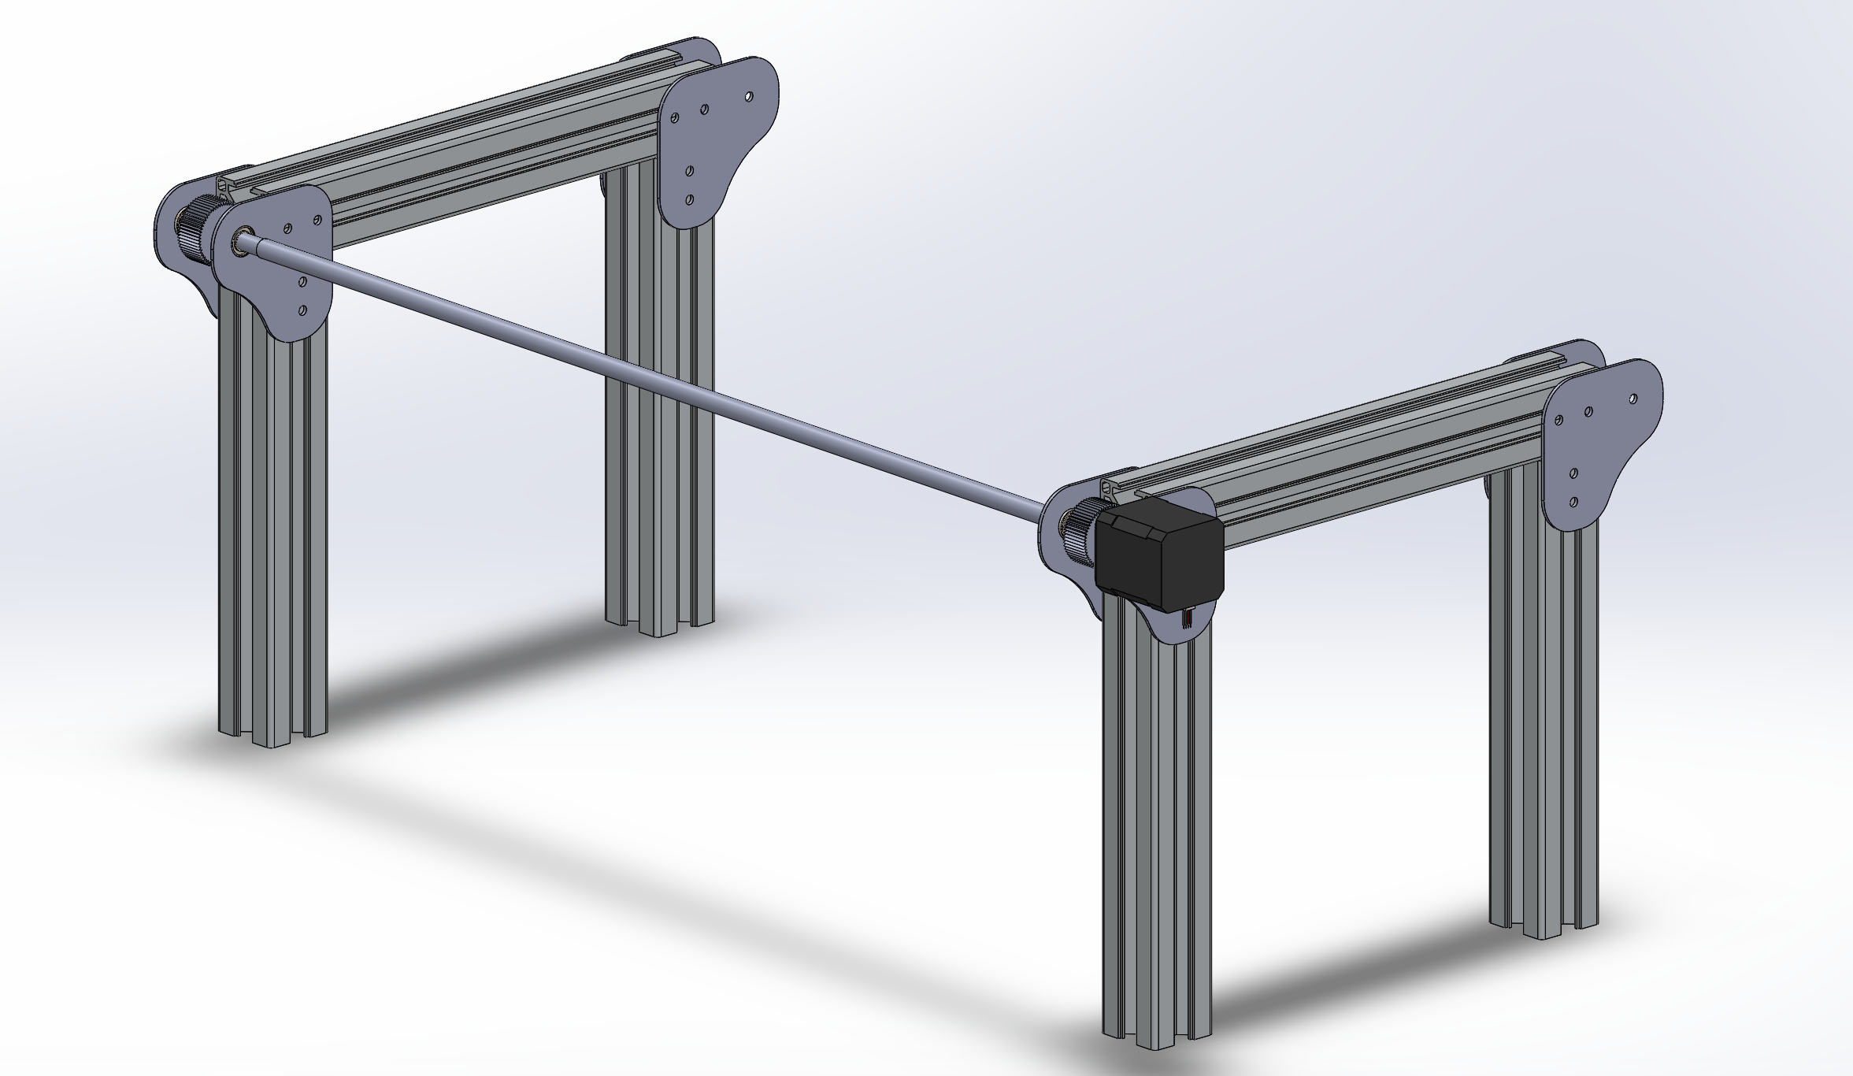
Step 2-3 – Power shaft and feet assembly

Slide 21
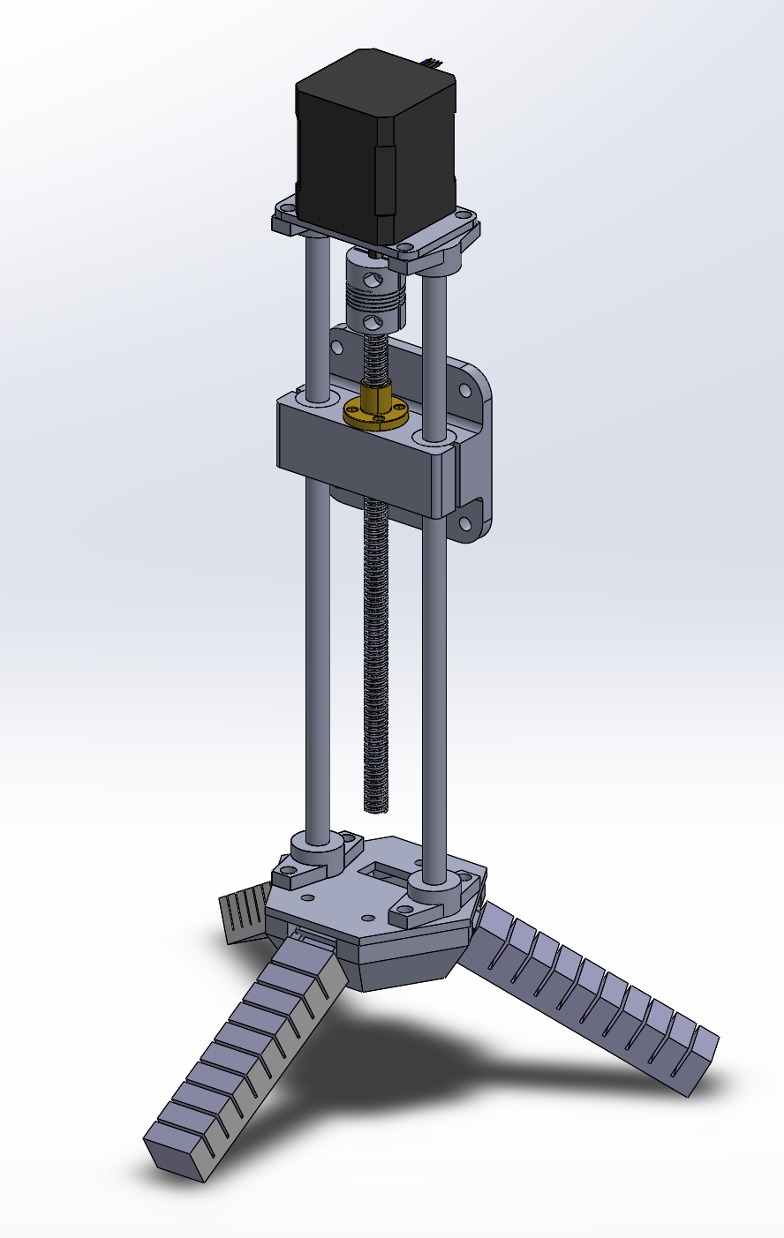
Step 4 – Gripper assembly

Slide 22
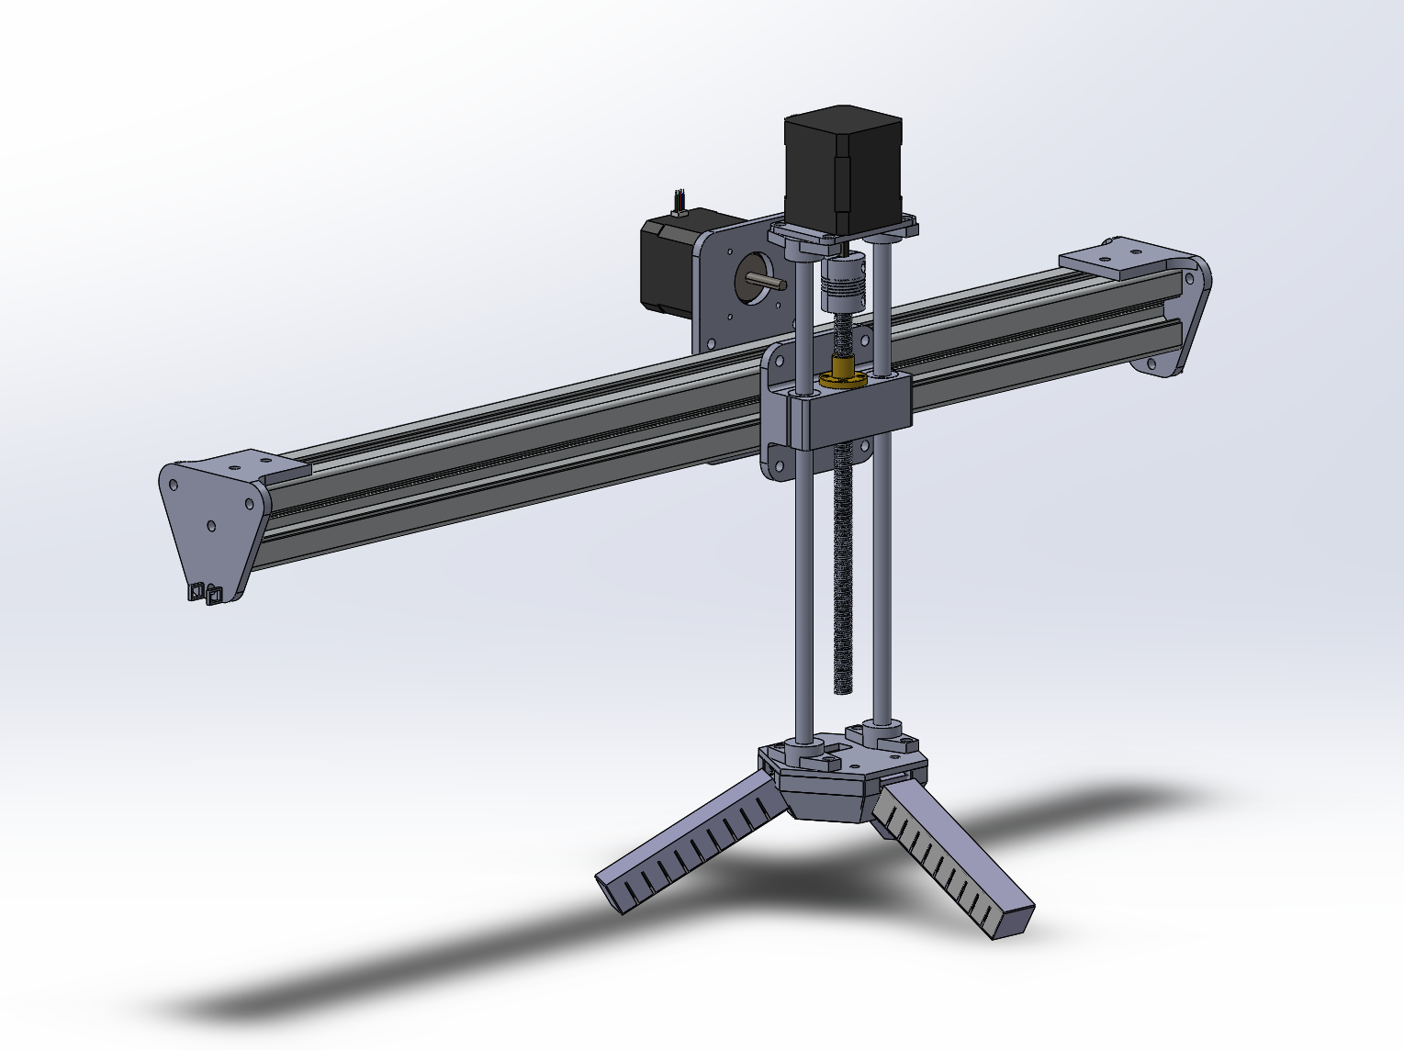
Step 5 – Y axis mount with belt and gripper

Slide 23
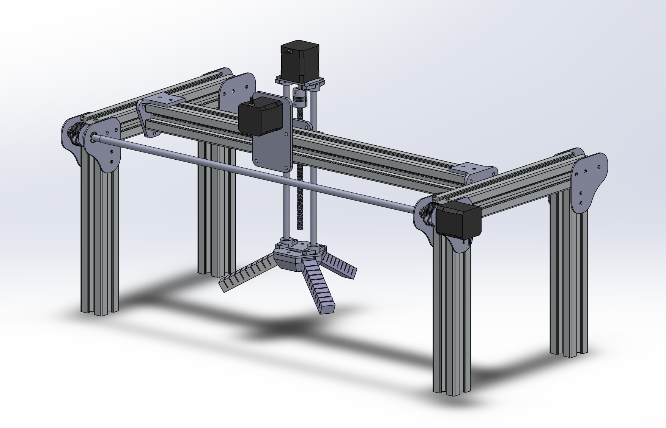
Step 6 – Y axis mounted to frame + X belts

Slide 24
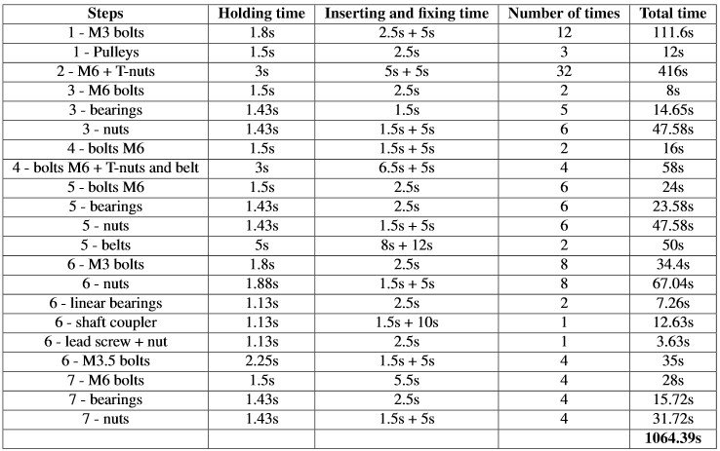
Assembly time
Using the tables given in the Design Methodology course, the assembly time can be estimated:
It takes 17 minutes and 44.39 seconds to theoretically assemble the robot
+/- 27 robots per working day

Slide 25
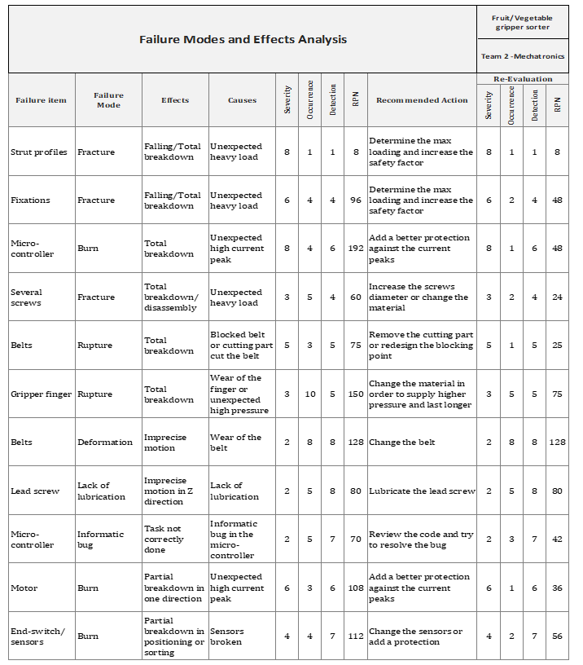
FMEA

Slide 26

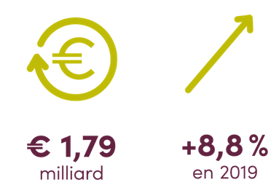
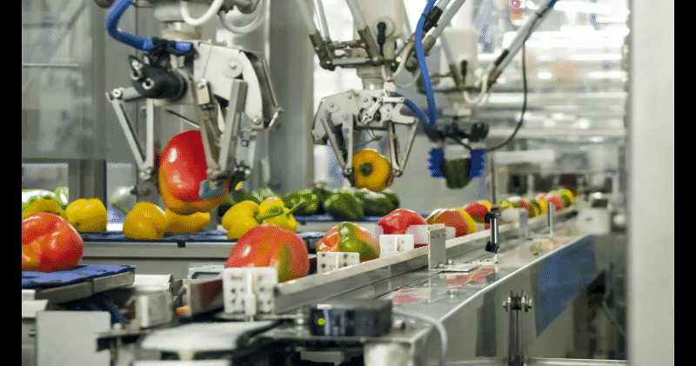
Business Development – Market analysis
SMB centered sector
Biggest industrial investor
Lots of competitors
22 employees per employer in average
96% of employers with less than 100 employees
PROEX FOOD robot
Sector in big expansion
From as cheap as few thousands euros per robots
Images and numbers are coming from the FEVIA (Belgian federation of the food industry)

Slide 27
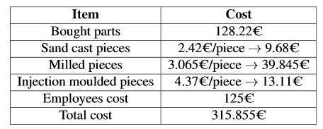
Business Development – Marketing strategy
Total price estimated using:
Prices found on internet for the bought components
Price estimator for the manufactured pieces
5 employees to build and sell 100 robots per month (2500€/month)
Sell price set to 500€
Price can be lowered to 400€ to support the small companies during the crisis, lauch the product and build some trust relationships
100 products sold/month 18,415€/month profit

Slide 28
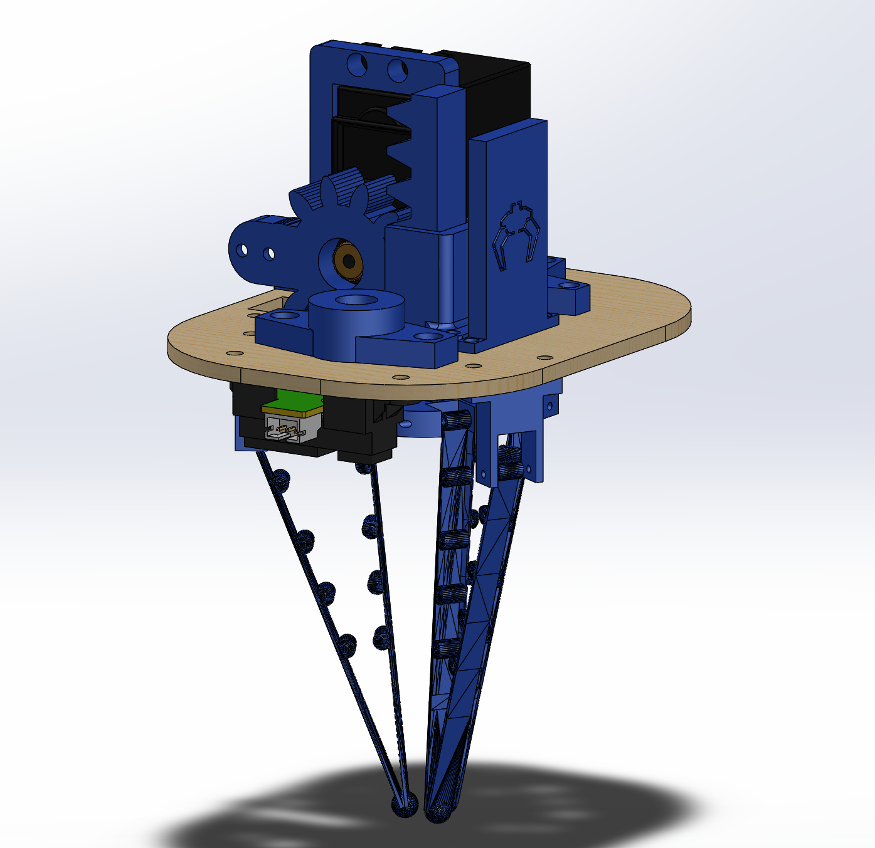
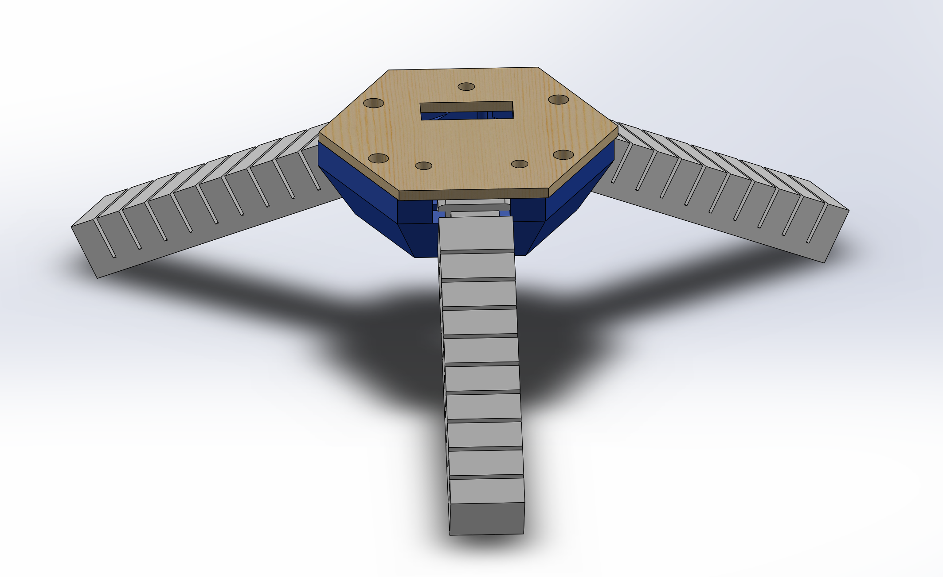
Prototype – Gripper change
Due to time contraints due to COVID 19, we chose to switch to a flexible gripper for the prototype

Slide 29
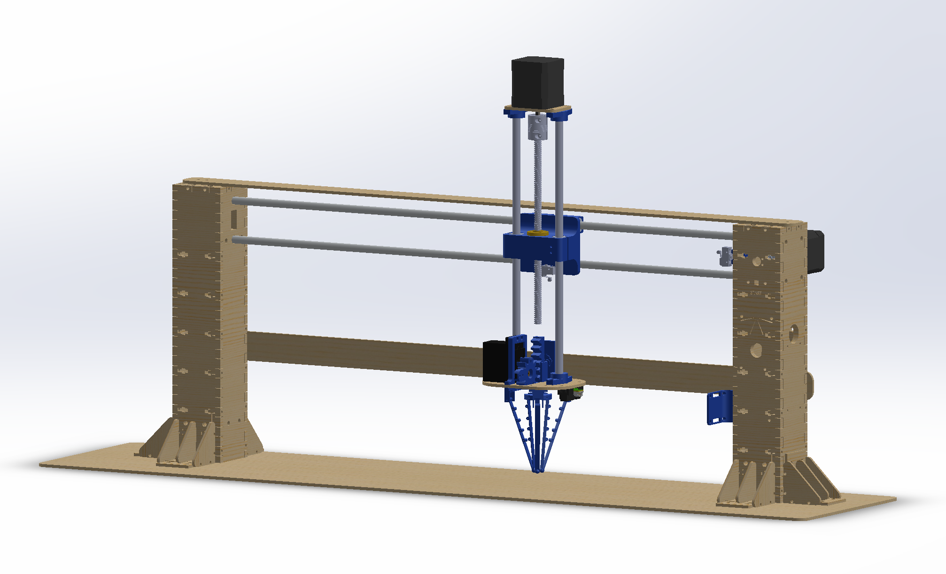
Prototype - CAD

Slide 30
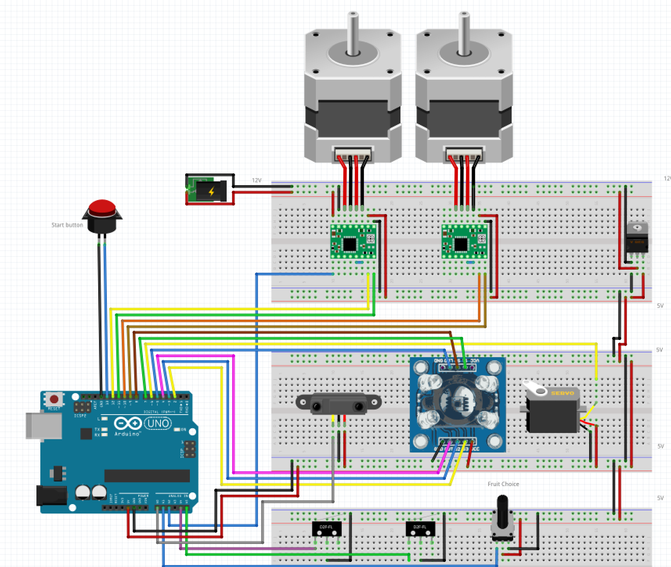
Prototype - Electronics
Operating 12 V
Bipolar stepper motor
Stepper motor driver
12V power supply
Buck converter 12V->5V
Operating in 5V :
Color sensor
Range sensor
Switches
Potentiometer
Stepper motor driver
Servo Motor
Arduino

Slide 31
Protoype - Choice for electronic components
Range (Distance) Sensor
 | Material | Range | Environment
Requirements | Fruits of different color and ground | 100-250mm | Standard
Ultrasonic (HC-SR04) | Any color and material are ok | 60-800mm | Standard but echo could be a problem
IR (QRB1113 ) | Reflective surface, any colour | 0-~150mm or ~150-500mm but need signal conditioning | No direct or indirect sunlight
Sharp IR (GP2Y0A41SK0F) | Any surface, any color | 40-300mm | Standard
Stepper motor driver
 | Current | Voltage input | Price
Requirements | 0.4A | 12V | Lowest
Easy Driver | 750mA | 30V | 2,93€
A4988 | 2A | 35V | 1,64€
TB6600 | 3.5A | 42V | 13€
Matureness identification
 | Sensitivity | Signal conditioning
Requirements | Moderate | Arduino readable
Camera | High | Not Arduino readable
Color sensor TCS3200 | Low to Moderate | Pulse corresponding to wavelength
Stepper motor
 | Torque max needed | Price | Voltage
Requirements | 10Ncm | Low | 12V
NEMA 17 17HS13-0404S1 | 26Ncm | 7.02 € | 12V
NEMA 14 14HS17-0504S | 23Ncm | 11.37 € | 7.5V
NEMA 23 23HS16-2804D | 55Ncm | 14.03 € | 2V

Slide 32
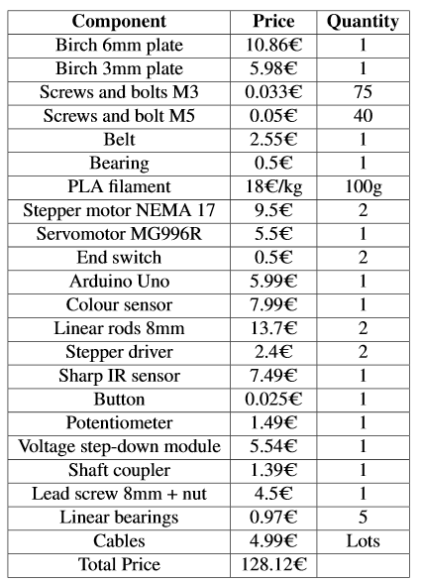
Prototype – Price
Total budget of 200€
Total cost of 128.12€

Slide 33
Code schematic
Transport mode
If color of fruit selected
Placing object in OK position
If no object found
Waiting for user input
Reseting
and checking for fruit selected
Scanning for object
Going to object, grabbing it
Going to color sensor and checking if color of fruit selected
Reseting
Placing object in not OK position
If not color of fruit selected

Slide 34
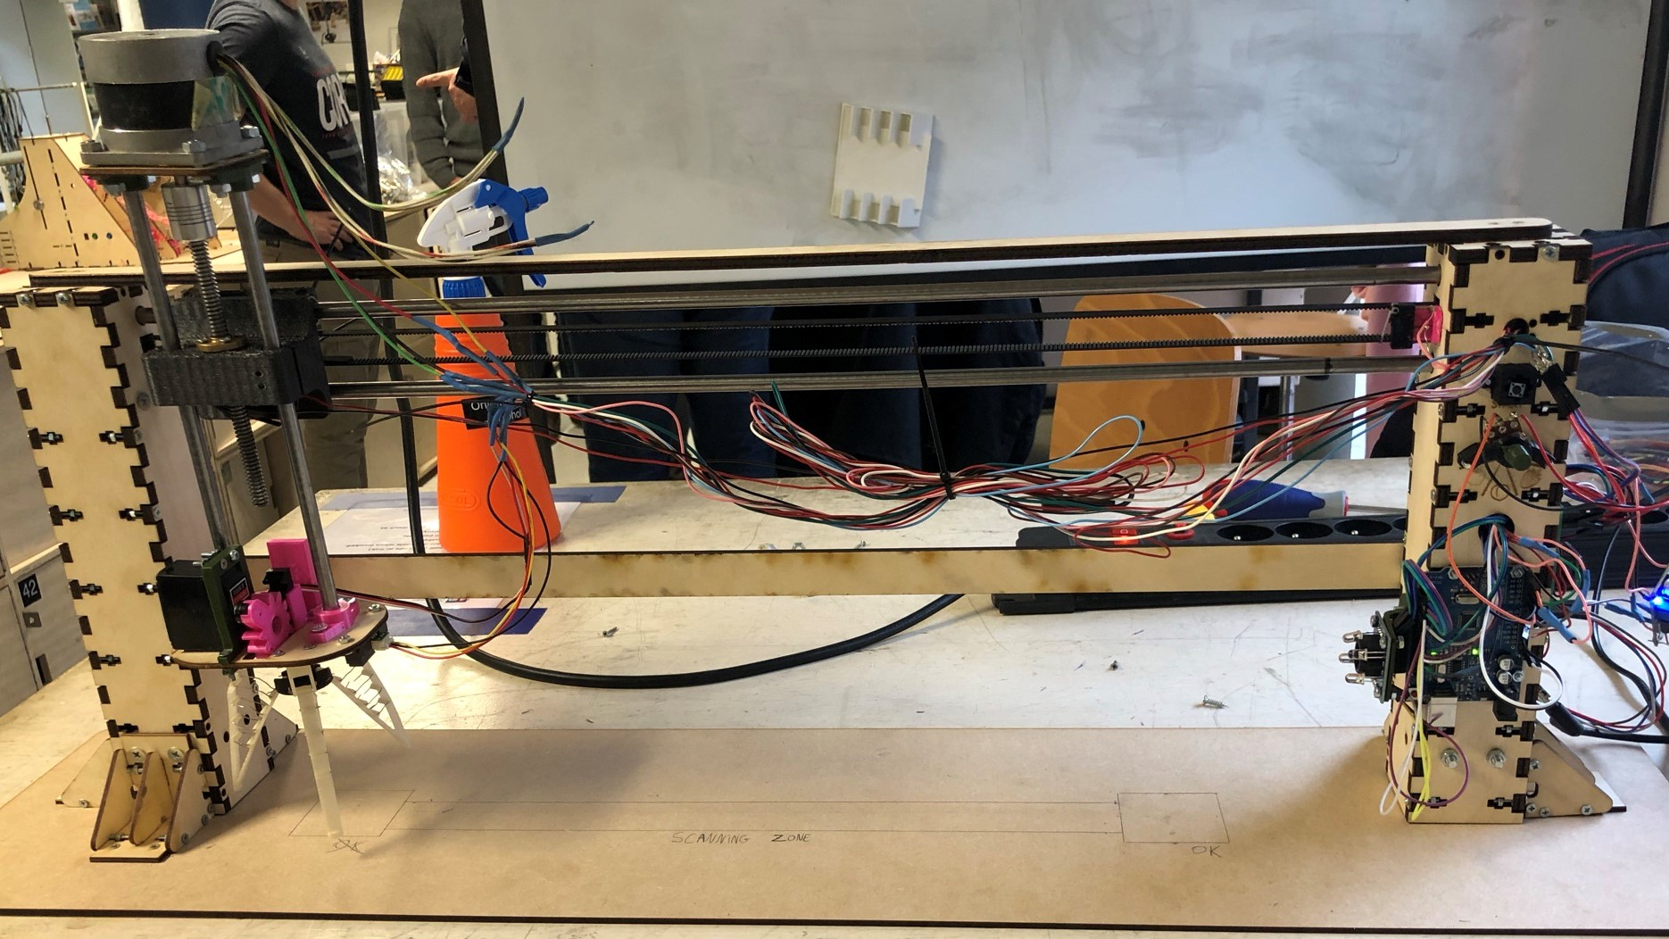
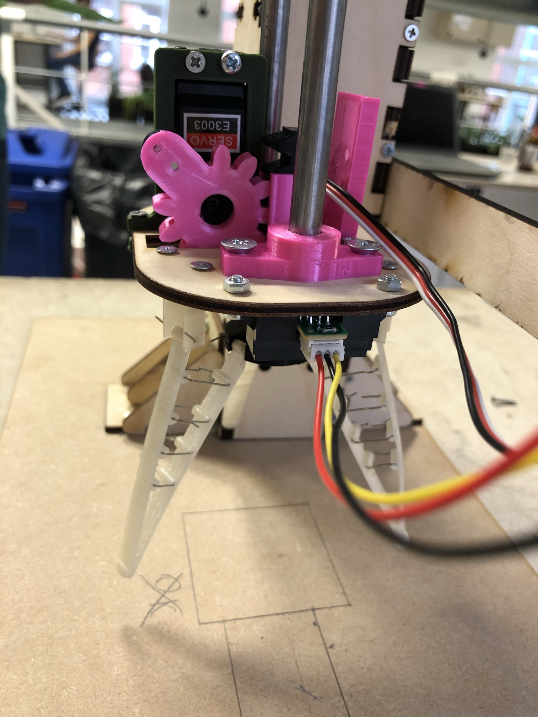
Prototype - Build

Slide 35
Prototype – Results and Discussion
Achievements
Color detection
YZ motion
Object detection
Switch between fruit detected
Grab object
Problems encountered
Glue due to the absence of M2 screws
Lots of friction in the Z axis (due to tilted axis)
Very slow Z motion due to small tooth pitch
Lots of stresses on the YZ fixation (for a 3D printed part)
Cable management

Slide 36
Conclusion
We started with a basic project topic of selecting an object and an actuated gripper and we produced a fully automated robot that sorts fruits and vegetables based on their color
During this whole experience of designing and developing a fully working robot, we learned many things like
Developing a design from scratch, with only a topic in hand. This helps us to train our problem-solving and creative skills
To optimize our product to a minimum number of parts and at the same time it could be interchangeable in case of any failure
To brainstorm to get to the best possible solution
Time Management
Further improvements can be made like
Due to time constraints, we switched to a flexible gripper so, instead, soft grippers can be developed which would have greater product life and easy handling
Find a way to avoid the tilting of the Z-axis that decreases the Z motion speed.

Slide 37

Q&A

